Slide 1
Introduction to HoloLens Development
Adrian Foster and Gry Nagel, Bouvet

Slide 2
Content
Quick introduction of the technology and toolkit
Live project setup
Tasks (https://github.com/grynag/booster-mr-2019 )
HoloLens demonstration

Slide 3
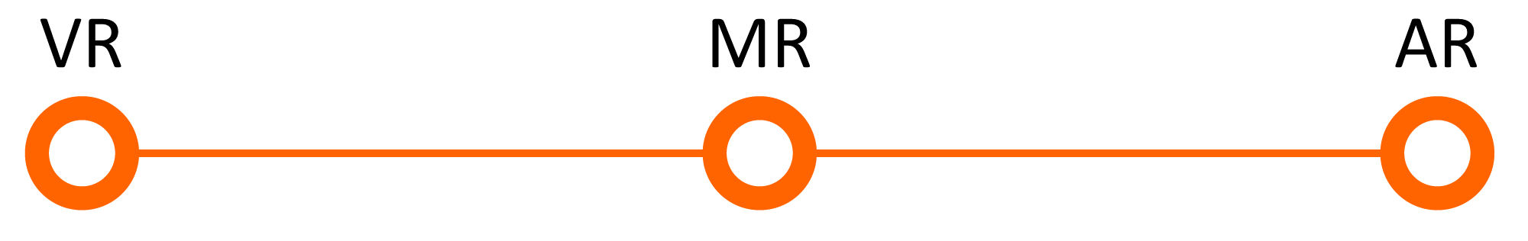
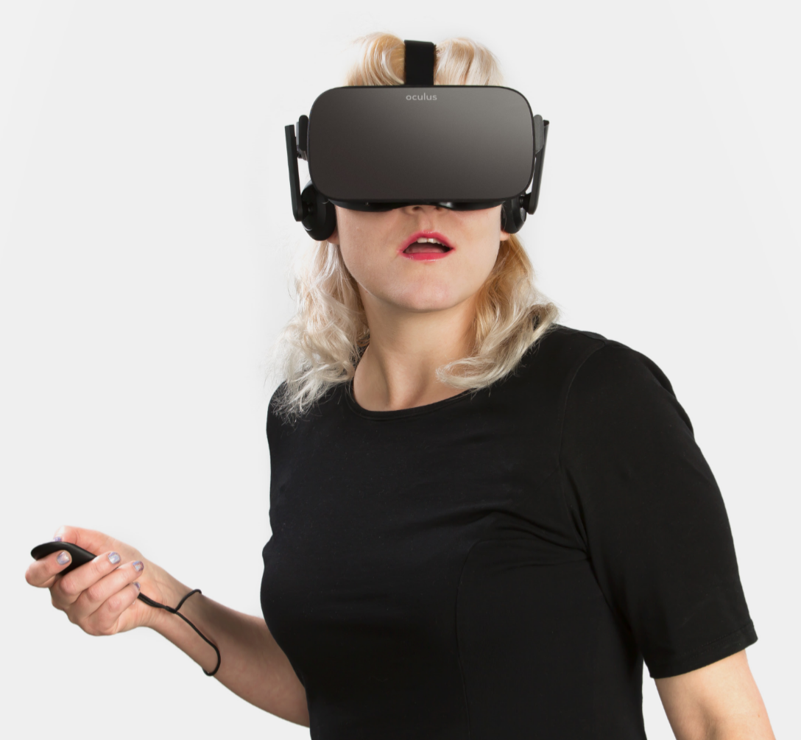
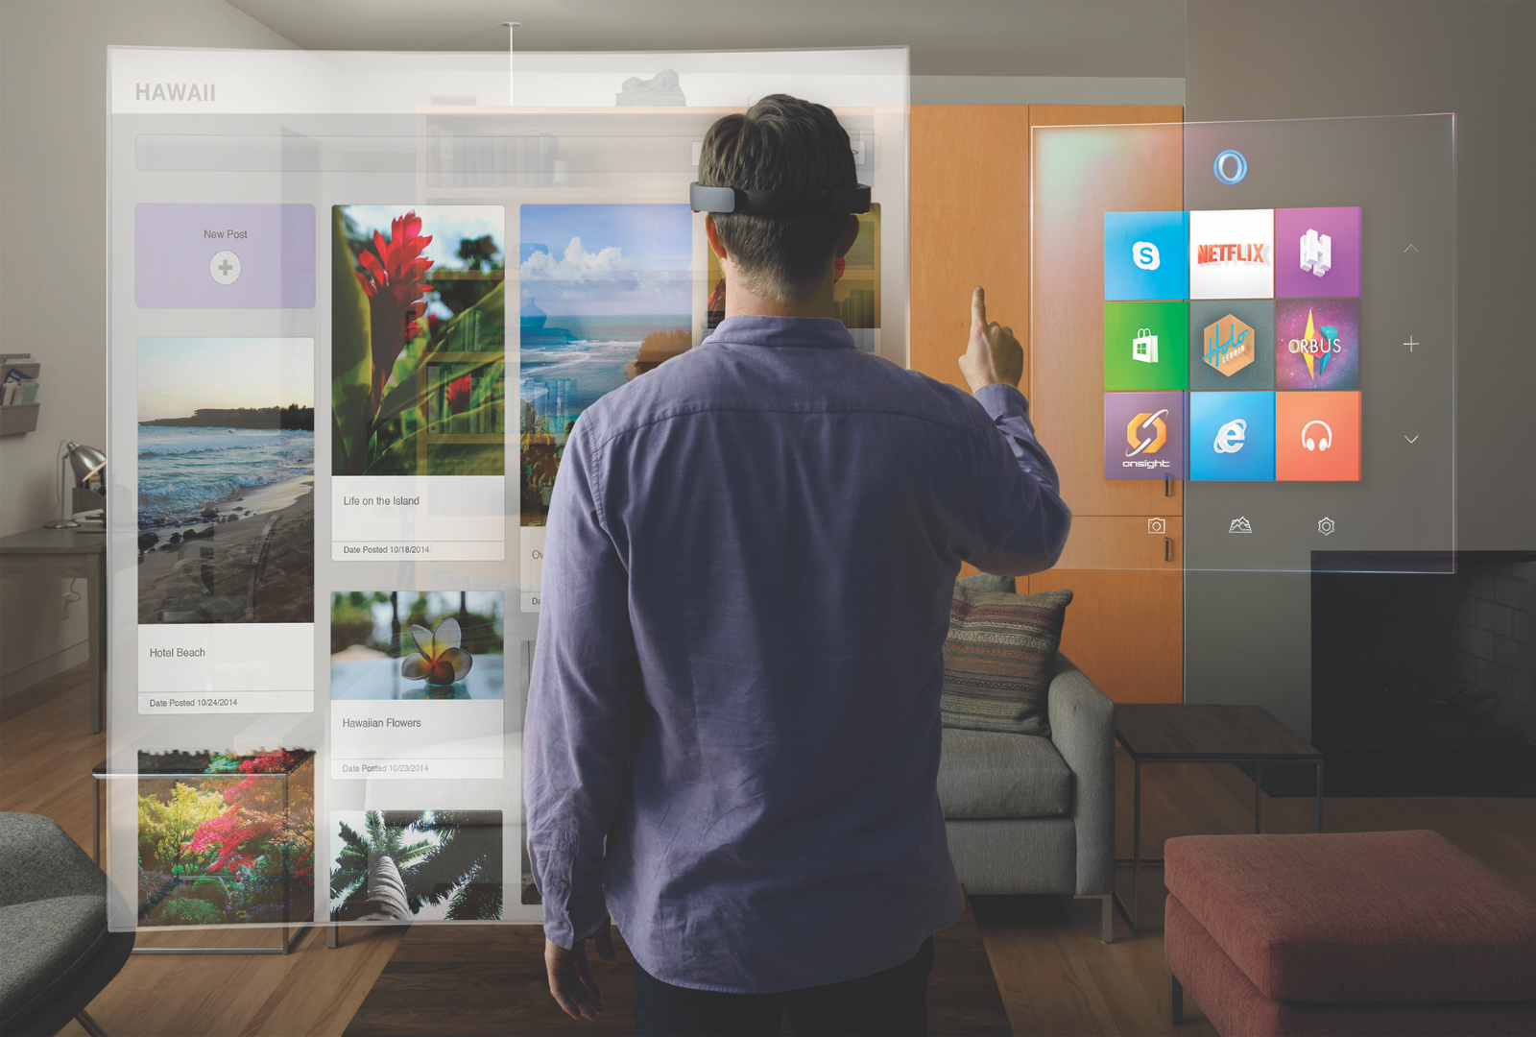
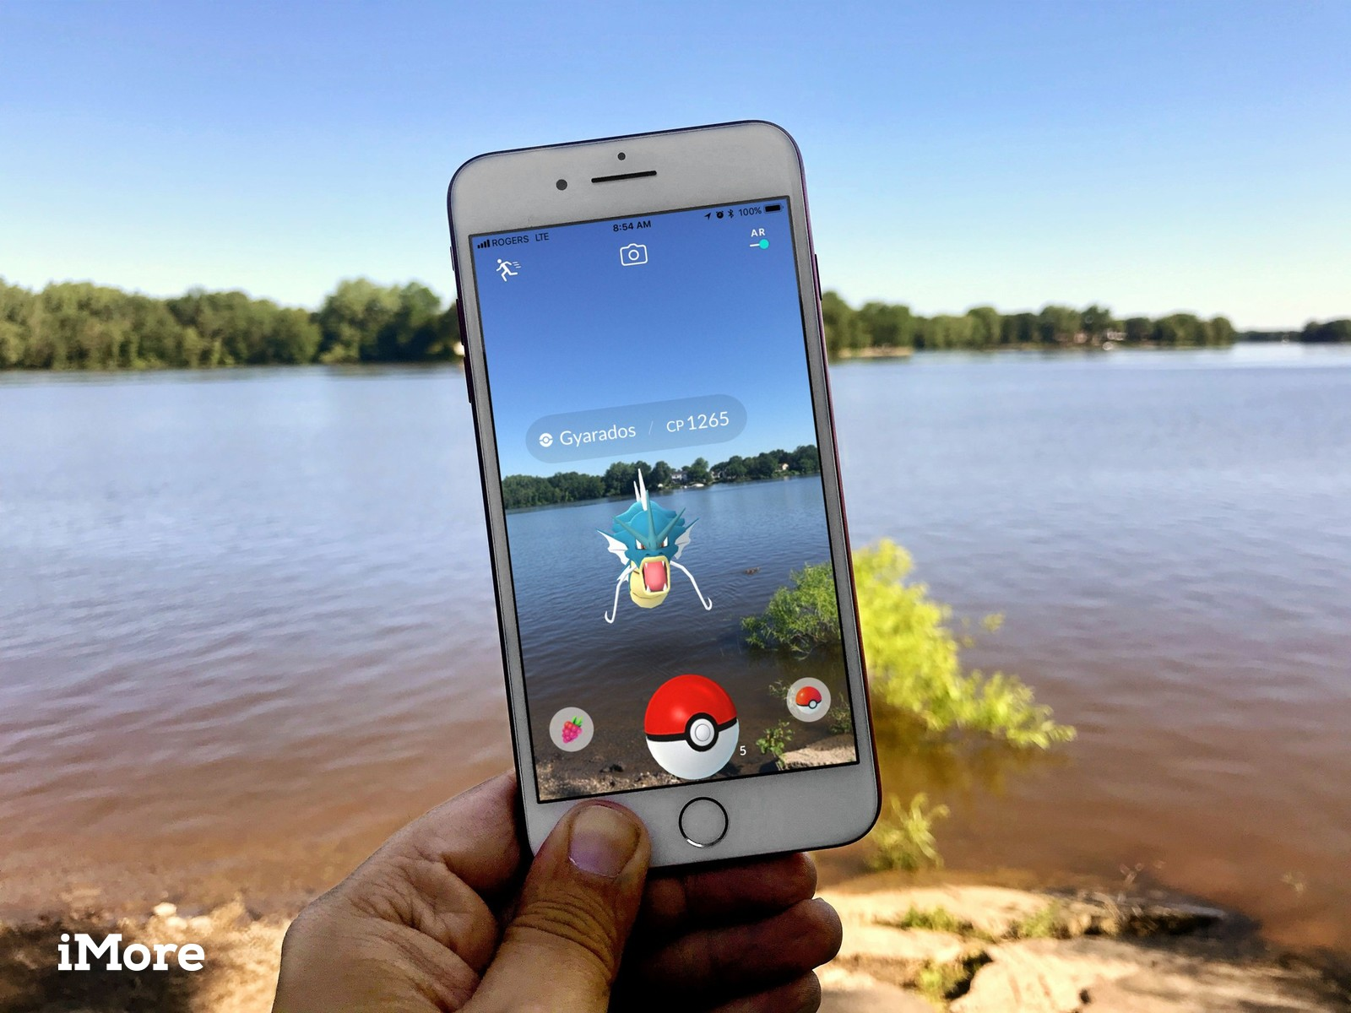
What is Mixed Reality?
Oculus materials used with permission. © 2016 Oculus VR, LLC. All Rights Reserved
Microsoft
IMore
Notes:
VR: replace
AR: add
MR: integrate

Slide 4
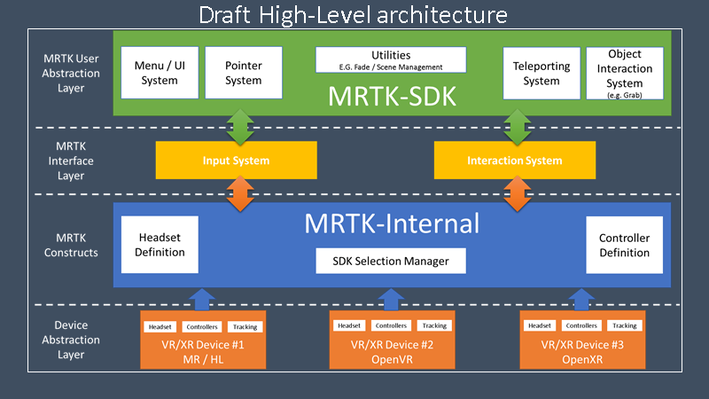
MRTK High-Level architecture
Notes:
https://github.com/Microsoft/MixedRealityToolkit-Unity/blob/mrtk_release/MRTK-vNext.md#outline-architecture

Slide 5
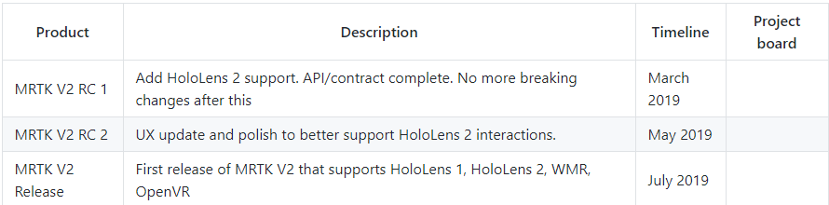
Mixed Reality Roadmap

Slide 6
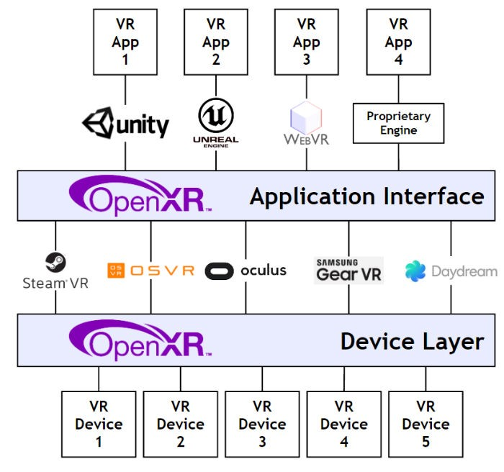
Cross-device
Notes:
https://github.com/Microsoft/MixedRealityToolkit-Unity/blob/mrtk_release/MRTK-vNext.md#open-xr-references

Slide 7
What we are going to make
A new Mixed Reality project in Unity
Adding a 3D model and using:

Slide 8
Resources
Set up
Mixed Reality Toolkit

